Slide 1
Dos and Don’ts for IDP CVs

Slide 2




Dos and Don'ts for IDP CVs
Dos
Don'ts
Use the Correct Template: Example – While responding to World Bank RFPs , create your CV using the WBGA template.
Ensure Consistency with LinkedIn: Make sure your LinkedIn profile contains the same details as your CV- many a times evaluator check
Accurate and Verifiable Professional Experience: Provide detailed descriptions of your professional experience per project, your role, your title, including critical tasks handled, project title, duration of involvement – project dates, and the organizations you worked with.
Accurate Educational Qualifications: Ensure your post-graduate and under-graduate degree details are mentioned in full with proper streams. Ex: Bachelor of Technology (B.Tech) in Computer Science and Masters in Business Administration (MBA) in Finance.
Latest Contact Information: Ensure your contact details are current and easily accessible, including phone number and email address
Include Publications and Certifications: Include relevant publications and certifications to showcase your qualifications and expertise.
List Countries of Work Experience: Include the countries where you have worked in the last ten years to demonstrate your international experience.
Highlight Memberships: Mention any memberships in professional associations, as these can enhance your credibility.
Adhere to required page limits: Follow the page limit requirements. For instance, the UN CV is typically limited to single page.
Specify Language Proficiency: Clearly mention languages you can read and write, along with your proficiency levels using the Common European Framework of Reference (CEFR) standards.
Always provide your consent for your CV to be used and make sure you sign off the contents of the CV before it gets shared with the client. Please ask your colleague to have your CV reviewed in case another team is creating the response.
Include False Information: Avoid writing any false project contributions, skills, certifications, or degrees in your CV, as this can lead to disqualification.
Omit Certification Details: Ensure all details of certifications are included, such as expiry dates.
Neglect Educational Qualifications: Clearly mention your highest educational qualifications, including the names of institutions and degrees obtained.
Be Vague: Be specific about your roles, responsibilities, and achievements in previous positions. Ex: Don’t claim team leader role if you worked as a consultant on a project.
Omit Relevant International Experience: Highlight any work with NGOs and international organizations, as this experience is particularly relevant for International Development accounts.
Avoid Lengthy CVs: Keep your CV concise and relevant to the position you are applying for, avoiding unnecessary details.
Forget to Sign and Date your CV: This certifies that the information provided is accurate to the best of your knowledge.
Conflict of Interest*: Avoid using CVs of external experts, serving for competing firms for the same bidding process.
Have any grammatical or typo errors. Do read your CV before submitting

Slide 3

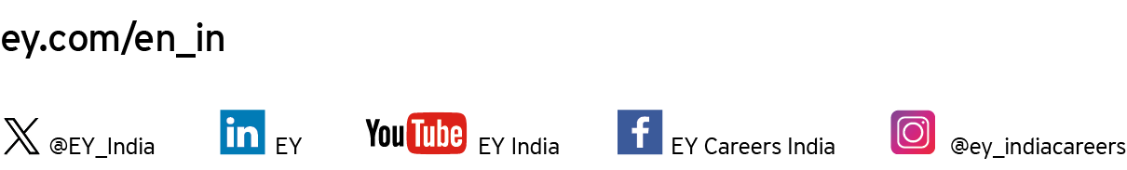
Ernst & Young LLP
EY | Building a better working world
EY is building a better working world by creating new value for clients, people, society and the planet, while building trust in capital markets.
Enabled by data, AI and advanced technology, EY teams help clients shape the future with confidence and develop answers for the most pressing issues of today and tomorrow.
EY teams work across a full spectrum of services in assurance, consulting, tax, strategy and transactions. Fueled by sector insights, a globally connected, multi-disciplinary network and diverse ecosystem partners, EY teams can provide services in more than 150 countries and territories.
All in to shape the future with confidence.
EY refers to the global organization, and may refer to one or more, of the member firms of Ernst & Young Global Limited, each of which is a separate legal entity. Ernst & Young Global Limited, a UK company limited by guarantee, does not provide services to clients. Information about how EY collects and uses personal data and a description of the rights individuals have under data protection legislation are available via ey.com/privacy. EYG member firms do not practice law where prohibited by local laws. For more information about our organization, please visit ey.com.
Ernst & Young LLP is one of the Indian client serving member firms of EYGM Limited. For more information about our organization, please visit www.ey.com/en_in.
Ernst & Young LLP is a Limited Liability Partnership, registered under the Limited Liability Partnership Act, 2008 in India, having its registered office at Ground Floor, Plot No. 67, Institutional Area, Sector - 44, Gurugram - 122 003, Haryana, India.
© 2025 Ernst & Young LLP. Published in India. All Rights Reserved.
This publication contains information in summary form and is therefore intended for general guidance only. It is not intended to be a substitute for detailed research or the exercise of professional judgment. Neither EYGM Limited nor any other member of the global Ernst & Young organization can accept any responsibility for loss occasioned to any person acting or refraining from action as a result of any material in this publication. On any specific matter, reference should be made to the appropriate advisor.

